Slide 1
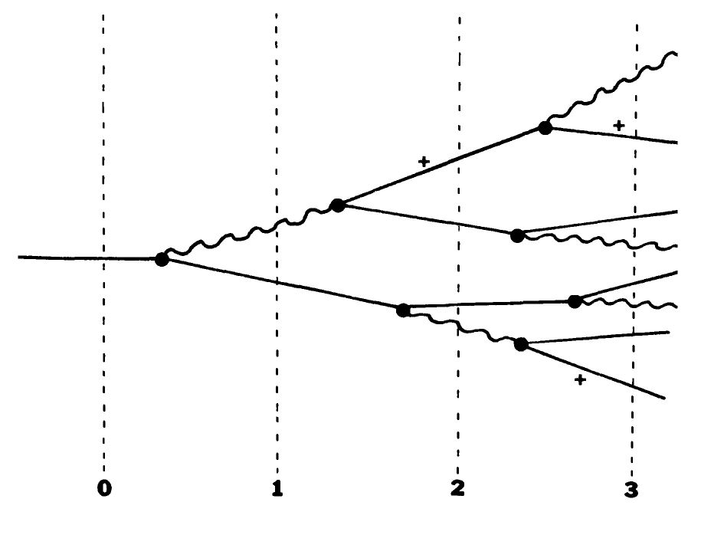
Electromagnetic shower
e⁻(E > 100 MeV), Bremsstrahlung
Photon(E>100MeV), pair production
Shower continues until particle’s energy falls below 100 MeV
X_{rad} = 180 A/Z² g/cm²
Assumptions

Slide 2
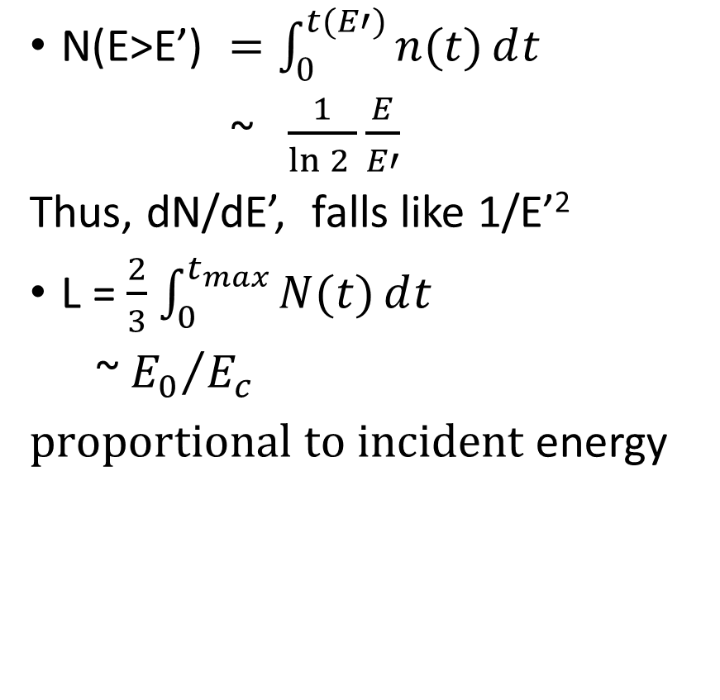
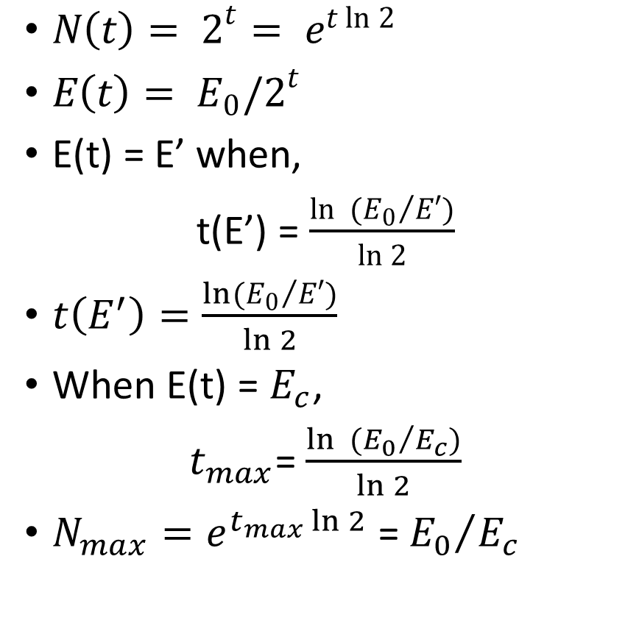
Heitler Model
$N\left(t\right)= 2^{t}= e^{t\ln{2}}$
$E\left(t\right)= E_{0}/2^{t}$­
E(t) = E’ when,
t(E’) = $\frac{\ln{ ({E_{0}}/{E′})}}{\ln{2}}$
$t\left(E^{′}\right)=\frac{ln⁡({E_{0}}/{E′})}{\ln{2}}$
When E(t) = $E_{c}$,
$t_{max}$= $\frac{\ln{ ({E_{0}}/{E_{c}})}}{\ln{2}}$
$N_{max}=e^{t_{max}\ln{2}}$ =${{ E}_{0}}/{E_{c}}$
$\text{N}\text{(}\text{E}\text{>}\text{E}\text{’) }=\int_{0}^{t(E′)}{n(t)ⅆt}$
~ $\frac{1}{\ln{2 }}\frac{E}{E′}$
Thus, dN/dE’, falls like 1/E’²
L = $\frac{2}{3}$ $\int_{0}^{t_{max}}{N(t)ⅆt}$
~${{ E}_{0}}/{E_{c}}$
$proportional to incident$ energy

Slide 3

Bremsstrahlung Radiation
E_{i} = E_{f} + k
Time rate of energy loss:
$$\frac{dE}{dt}=\frac{2e^{2}}{3c^{3}}a^{2}$$
quadratic dependence on ‘a’.
$\frac{d\text{σ}}{dk}=\frac{5e^{2}}{hc}{Z_{1}}^{4}{Z_{2}}^{2}(\frac{m c}{Mv_{1}})\frac{r_{e}2}{k} ln\frac{M {v_{1}}^{2}γ^{2}}{k}$

Slide 4

α $\frac{1}{M}$
α ${{ Z}_{2}}^{2}$
Cross section α$\frac{1}{k}$, with increasing photon energy
Contribution from atomic electrons α $Z$₂
Effects of screening!

Slide 5
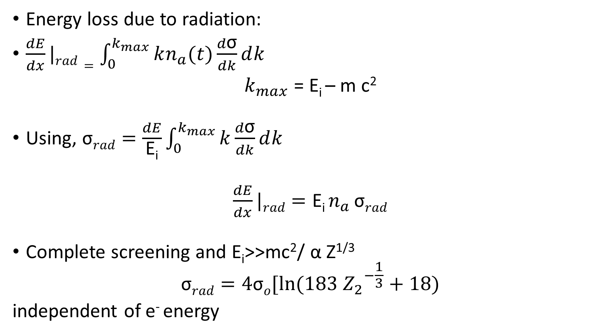
Energy loss due to radiation:
$\frac{dE}{dx}|rad=\int_{0}^{k_{max}}{kn_{a}(t)\frac{d\text{σ}}{dk}ⅆk}$
$k_{max}$ = E_{i} – m c²
Using, $\text{σ}rad=\frac{dE}{\text{E}\text{i}}\int_{0}^{k_{max}}{k\frac{d\text{σ}}{dk}ⅆk}$
$\frac{dE}{dx}|rad={\text{E}\text{i} n}_{a}$ $\text{σ}rad$
Complete screening and E_{i}>>mc²/ α Z^{1/3}
$$\text{σ}rad=4\text{σ}o[ln⁡(183{{ Z}_{2}}^{−\frac{1}{3}}+18)$$
independent of e⁻ energy

Slide 6

Collision energy α ln(E_{i})
$\text{σ}rad$ n_{a} : dimensions of L⁻¹
Radiation Length
L_{R}⁻¹ = 4 $\text{σ}o$ n_{a} ln(183 Z₂^{-1/3})
(X_{rad} = 180 A/Z² g/cm²)
$\frac{dE}{dx}|rad$ / $\frac{dE}{dx}|coll$ = $\frac{\text{Z}\text{2}\text{E}\text{i}}{1600 mc^{2}}$
E_{crit}= $\frac{1600 mc^{2}}{\text{Z}\text{2}}$

Slide 7
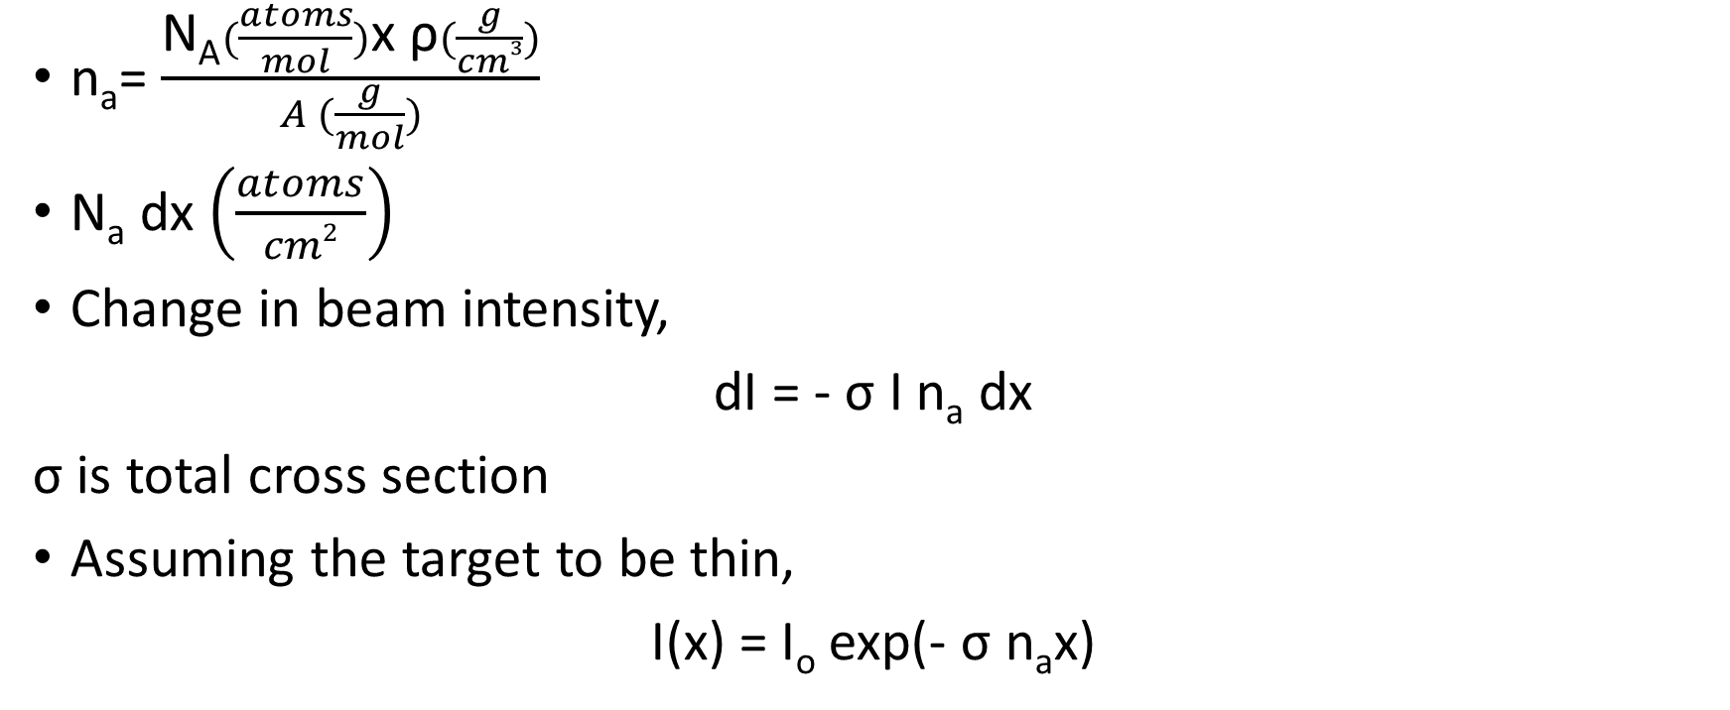
Interaction Length
n_{a}= $\frac{\text{N}\text{A}(\frac{atoms}{mol})\text{x} \text{ρ}(\frac{g}{cm3})}{A (\frac{g}{mol})}$
N_{a} dx $\left(\frac{atoms}{cm2}\right)$
Change in beam intensity,
dI = - $\text{σ}$ I n_{a} dx
$\text{σ}$ is total cross section
Assuming the target to be thin,
I(x) = I_{o} exp(- $\text{σ}$ n_{a}x)

Slide 8

Interaction Length:
λ_{I} = ($\text{σ}$ n_{a})⁻¹
When x = λ_{I}
I(x) = $\frac{\text{I}\text{o}}{e}$
λ_{I} represents mean free path between interactions

Slide 9
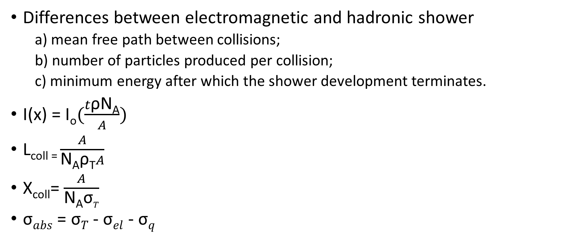
Hadronic Shower
Differences between electromagnetic and hadronic shower
a) mean free path between collisions;
b) number of particles produced per collision;
c) minimum energy after which the shower development terminates.
I(x) = $\text{I}\text{o}(\frac{t\text{ρ}\text{N}\text{A}}{A})$
L_{coll =} $\frac{A}{\text{N}\text{A}\text{ρ}\text{T}A}$
X_{coll}= $\frac{A}{\text{N}\text{A}\text{σ}T}$
$\text{σ}abs$ = $\text{σ}T$ - $\text{σ}el$ - $\text{σ}q$

Slide 10
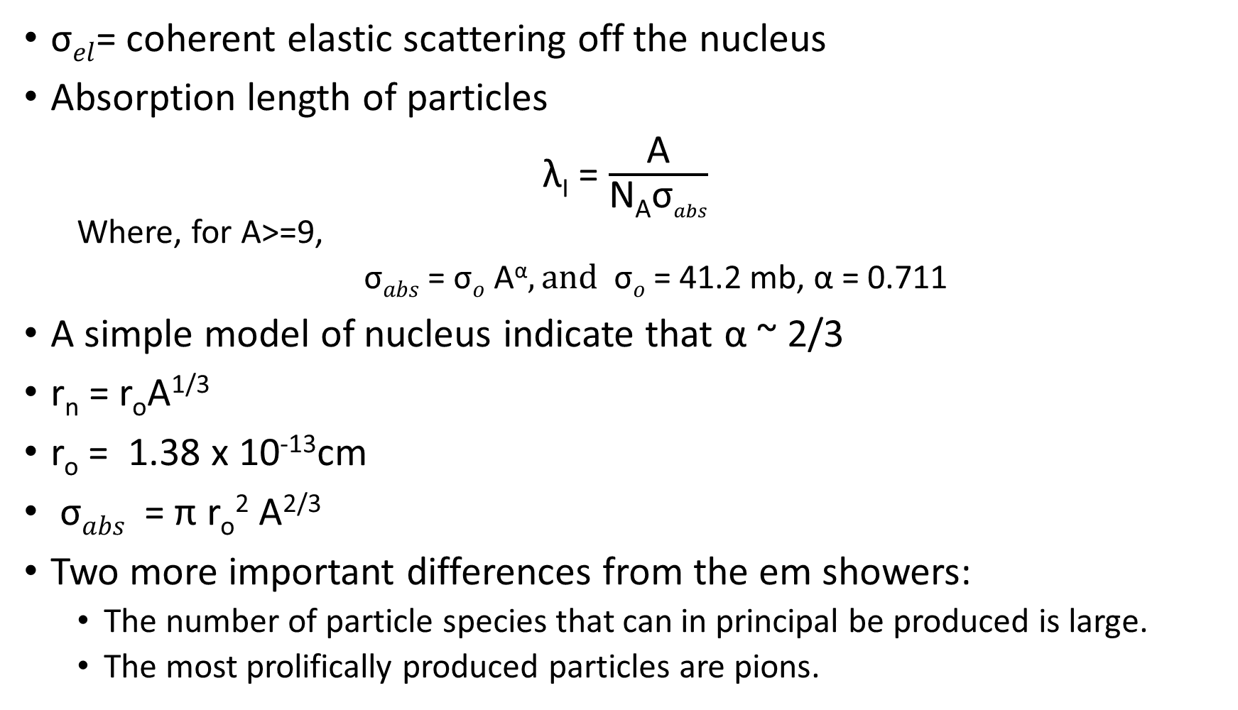
$\text{σ}el$= coherent elastic scattering off the nucleus
Absorption length of particles
λ_{I} = $\frac{\text{A}}{\text{N}\text{A}\text{σ}abs}$
Where, for A>=9,
$\text{σ}abs$ = $\text{σ}o$ A^{α}$, and \text{σ}o$ = 41.2 mb, α = 0.711
A simple model of nucleus indicate that α ~ 2/3
r_{n} = r_{o}A^{1/3}
r_{o} = 1.38 x 10⁻¹³cm
$\text{σ}abs$ = π r_{o}² A^{2/3}
Two more important differences from the em showers:
The number of particle species that can in principal be produced is large.
The most prolifically produced particles are pions.

Slide 11
Two more important differences from the em showers:
The number of particle species that can in principal be produced is large.
The most prolifically produced particles are pions.

